Slide 1

MACHINE LEARNING PROJECT 2
Deep Learning based Real World Urban Object Classification
Presented By: Group 1
Youngdae Seob
Sheshta Ramgoolam Sobun
Sorna Raj Shanmuga
Paul Qin Kwan

Slide 2
Project Overview
Step 1
Step 2
Dataset(addressing imbalance and Augmentation
Building the CNN Model
Step 4
Step 3
Step 5
Gradcam and Saliency Maps
Transfer Learning
Optimisation of CNN model

Slide 3
Dataset

Slide 4
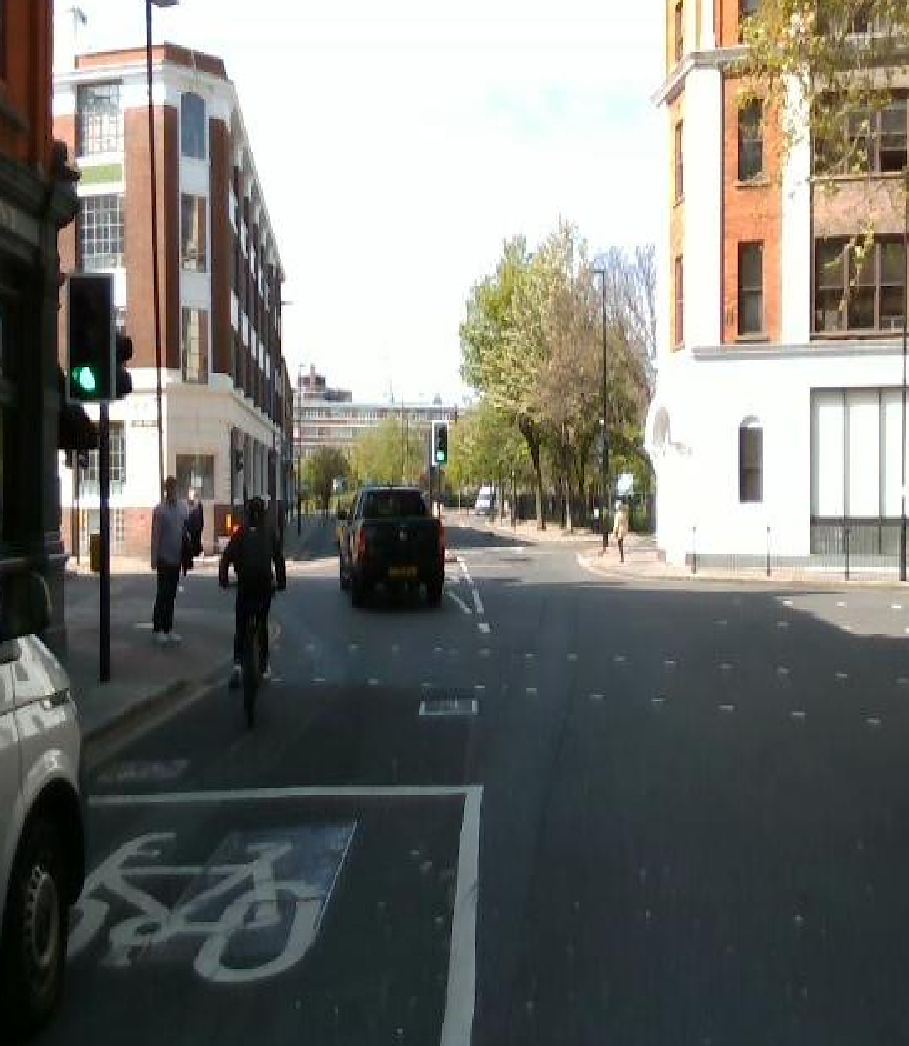
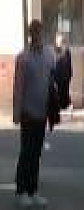
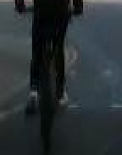
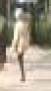


Data augmentation
Techniques Used:
Cropping
Small Rotation 20 degrees
Horizontal Flip
To address imbalance in dataset, more bikes and pedestrians were cropped and saved as separate files to match the ‘cars’ data distribution
Data Augmentation techniques were applied randomly to improve generalization and capability of our model, making them more effective in real-world applications
Notes:
# Augmentation configuration for training on minority classes
augmentation = ImageDataGenerator(
rotation_range=20,
zoom_range=0.15,
width_shift_range=0.2,
height_shift_range=0.2,
shear_range=0.15,
horizontal_flip=True,
fill_mode="nearest"

Slide 5
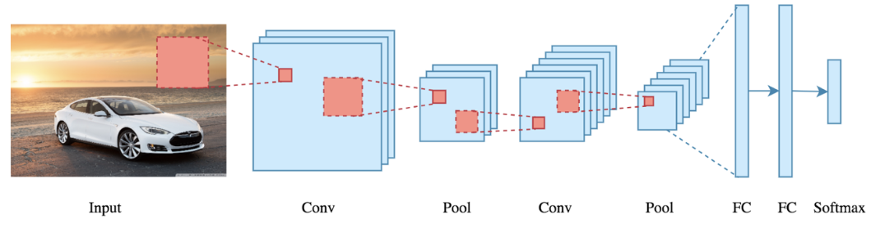
Deep Learning CNN Model
Convolutional layer performs a dot product between two matrices, where one matrix is the set of learnable parameters otherwise (kernel), and the other matrix is the restricted portion of the receptive field
Pooling Layer – responsible for reducing the spatial size of the convolved feature.
Max pooling – finds maximum value of a pixel from a portion of the image covered by the kernel. Max pooling also performs as a Noise Suppressant
FC- Neurons in this layer have full connectivity with all neurons in the preceding and succeeding layer as seen in regular FCNN.
ReLU- The Rectified Linear Unit computes f(x) = max(0,k). Accelerates the convergence by six times.

Slide 6
Debugging/Optimisation of cnn model
Trained Network
Dropout
Yes
No
Batch Normalisation
Use on valid and test set
Acceptable?
Overfitting
No
Yes
Weight Decay
Weight Initialisation
GAP?
Add/Remove Layers
Data Augmentation
Learning Rate Scheduler
Transfer Learning
Mini Batch Size

Slide 7
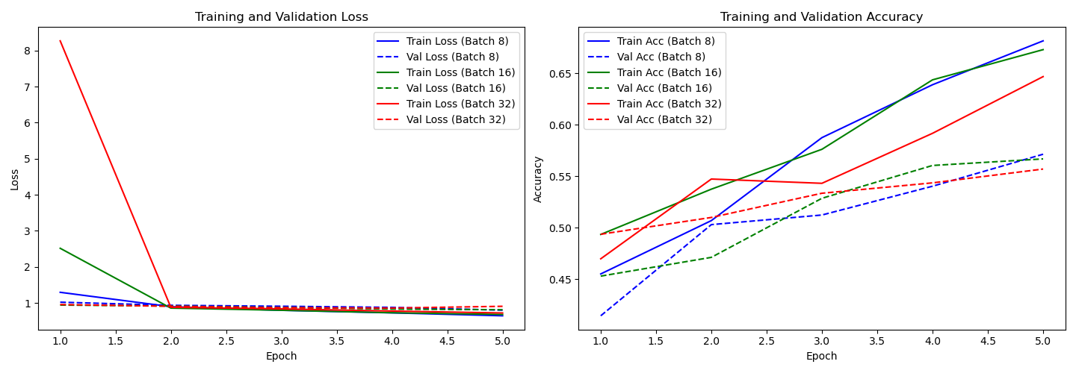
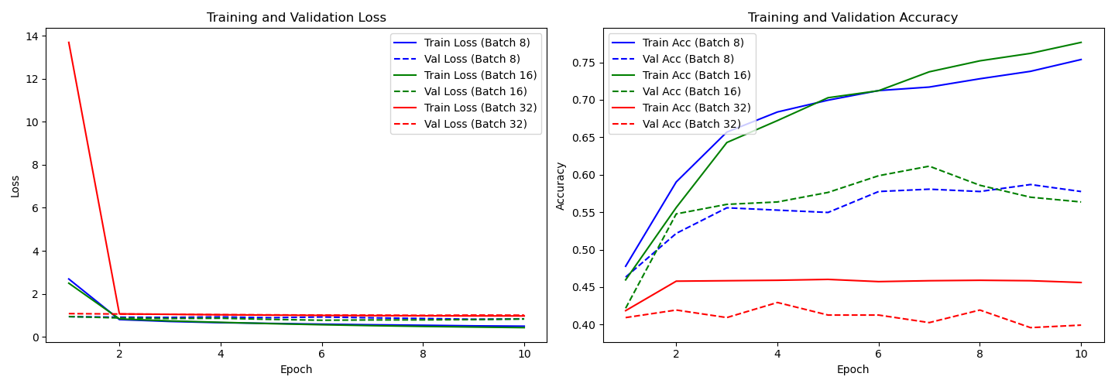
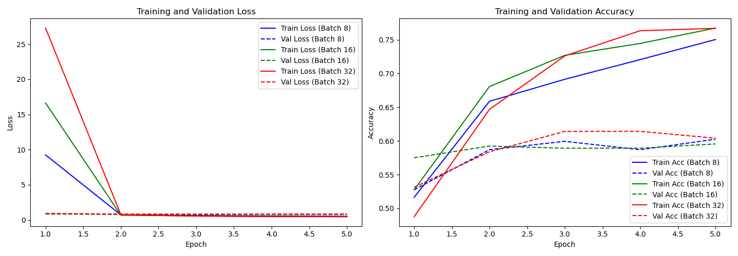
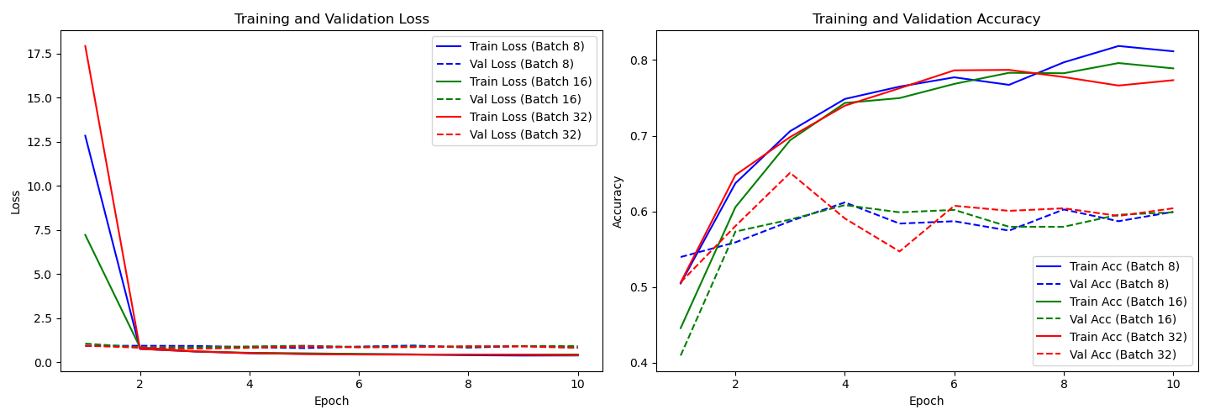
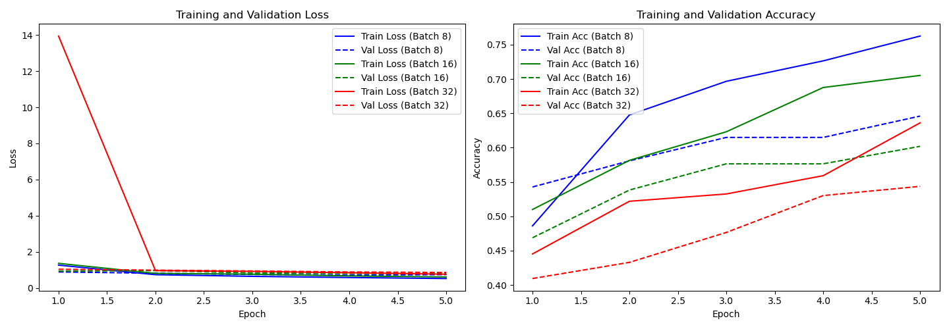
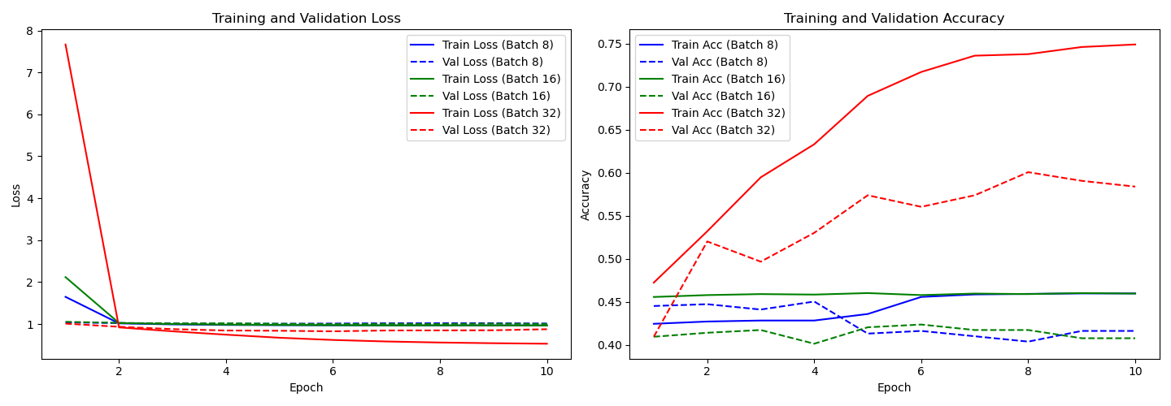
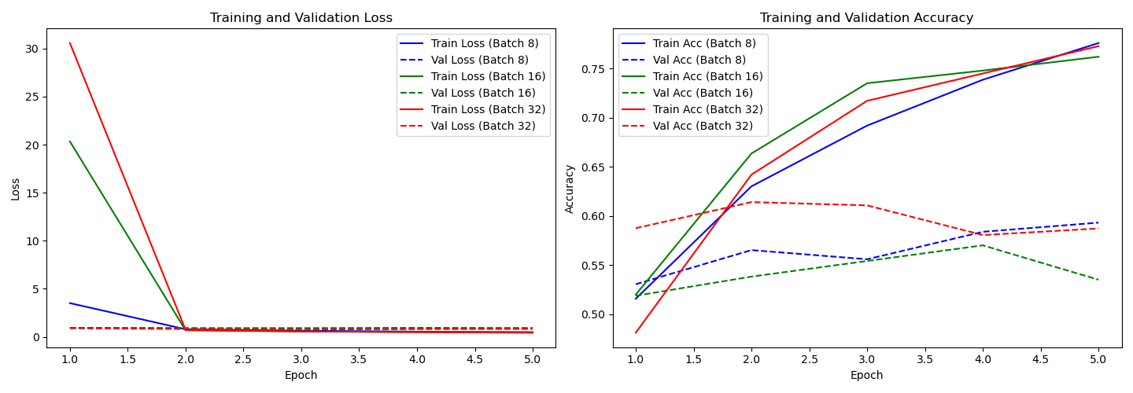
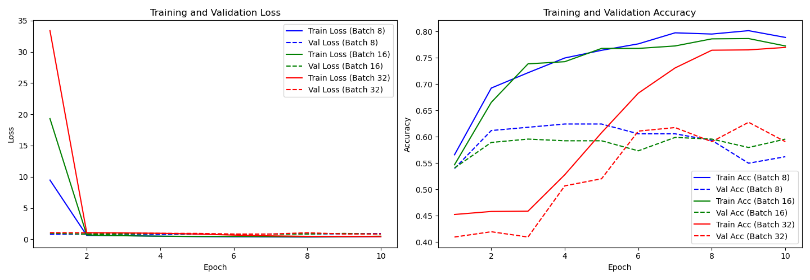
Xavier Uniform/Normal, Multi-step lr num of epochs = 5&10
Kaiming Uniform/Normal, Multi-step lr num of epochs 5&10
Uniform 5
Uniform 10
Uniform 5
Uniform 10
Normal 5
Normal 10
Normal 5
Normal 10
79%
Xavier |  | Uniform |  | Normal
 |  | 5 | 10 | 5 | 10
Batch 8 | Train | 68.145% | 75.379 | 76.254 | 45.974%
 | Valid | 57.143% | 57.764 | 64.596 | 41.615%
 | Test | 56% | 47.5 | 65 | 62.5%
Batch 16 | Train | 57.292% | 77.667% | 70.516 | 45.956%
 | Valid | 56.688% | 56.37% | 60.191 | 40.764%
 | Test | 63.75% | 41.25% | 63.75 | 63.75%
Batch 32 | Train | 64.675% | 45.621% | 63.609 | 74.911%
 | Valid | 55.705% | 39.933% | 54.362 | 58.389%
 | Test | 57.5% | 40% | 63.125 | 62.5%
Kaiming |  | Uniform |  | Normal
 |  | 5 | 10 | 5 | 10
Batch 8 | Train | 75.029% | 79.116% | 77.596% | 78.88%
 | Valid | 60.248% | 59.938% | 59.317% | 56.211%
 | Test | 55% | 65% | 65% | 55%
Batch 16 | Train | 76.729% | 78.898% | 76.201% | 77.257%
 | Valid | 59.554% | 59.873% | 53.503% | 59.554%
 | Test | 60% | 66.25% | 68.75% | 61.25%
Batch 32 | Train | 76.686% | 77.337% | 77.278% | 76.982%
 | Valid | 60.402% | 60.402% | 58.724% | 59.06%
 | Test | 65.625% | 68.75% | 68.125% | 60.625%

Slide 8
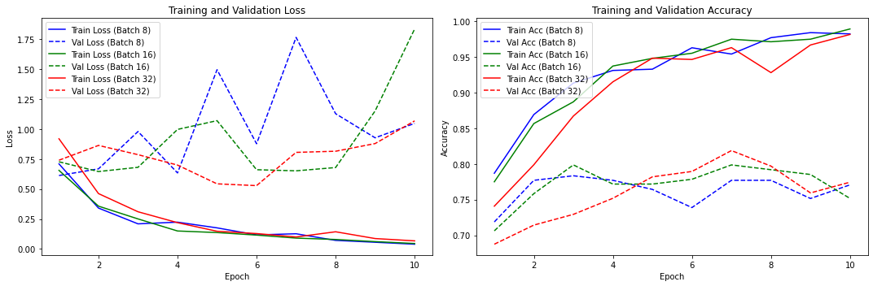
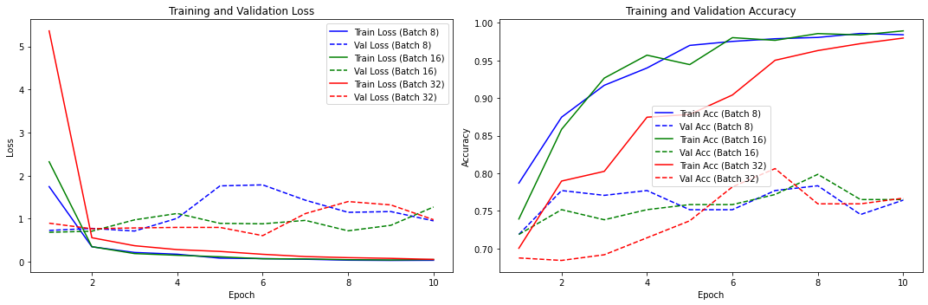
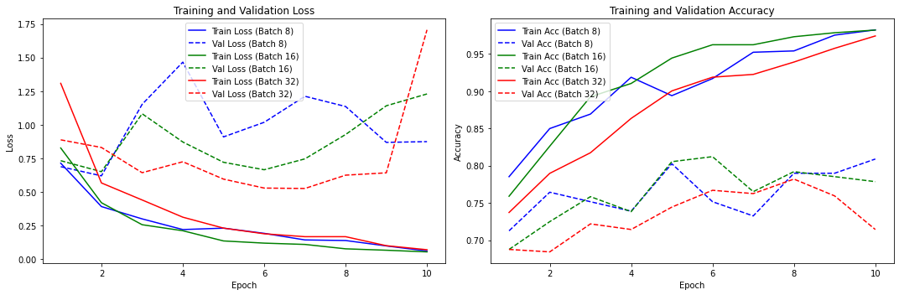
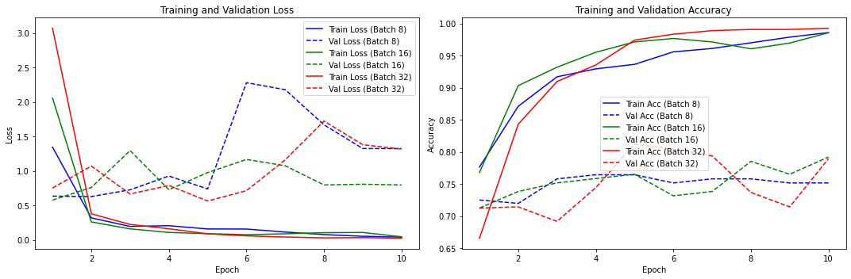
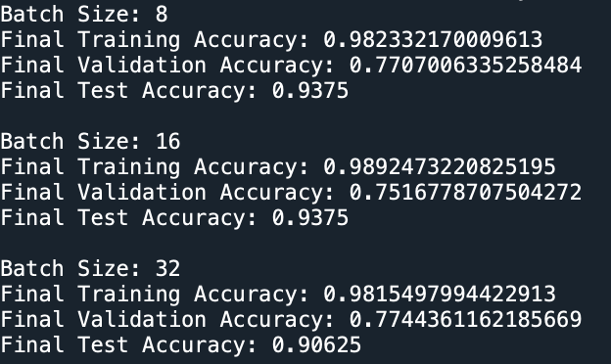
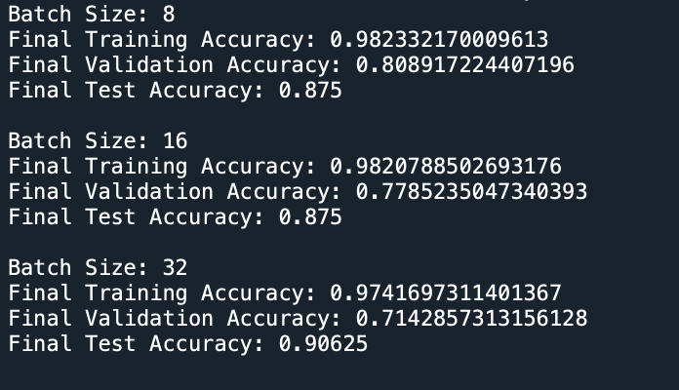
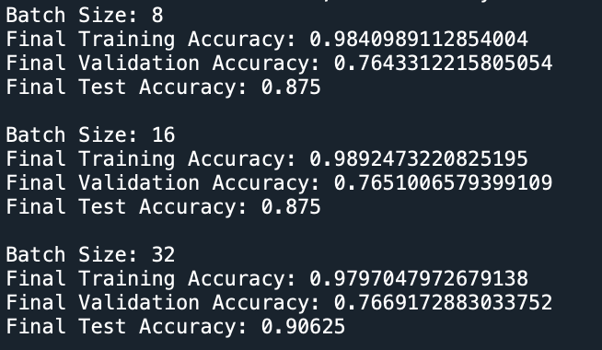
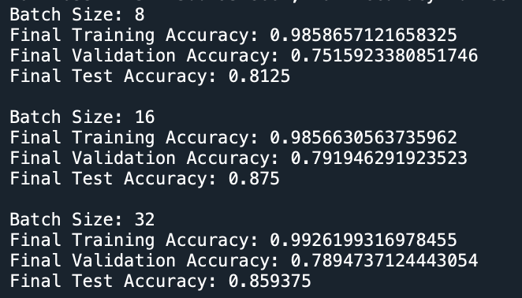
Xavier Uniform /Normal, EXPONENTIAL lr num of epochs = 10
Overfitting
Kaiming uniform/normal, EXPOnential lr num of epochs = 10
Xavier Uniform Xavier Normal Kaiming Uniform Kaiming Normal

Slide 9
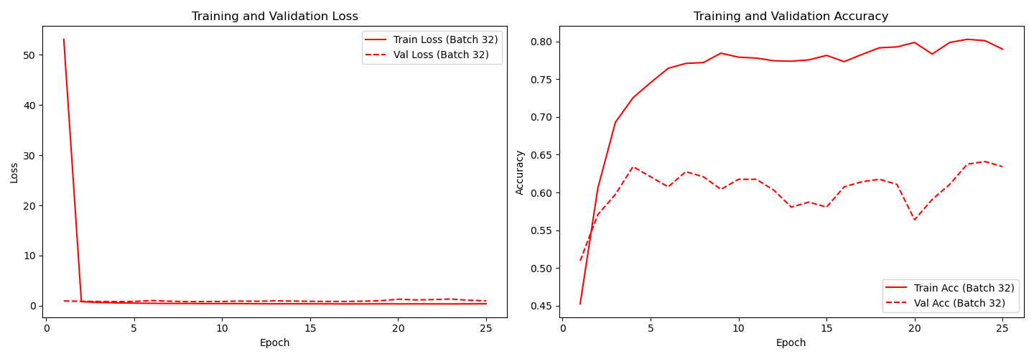
kaiming uniform, multistep lr, batch size = 8
Final Training Accuracy = 0.780994083404 || Final Validation Accuracy = 0.6342281699 ||Final Test Accuracy = 0.75625
8
8
Overfitting
8
8
Overfitting is an undesirable machine learning behavior that occurs when the machine learning model gives accurate predictions for training data but not for new data.

Slide 10
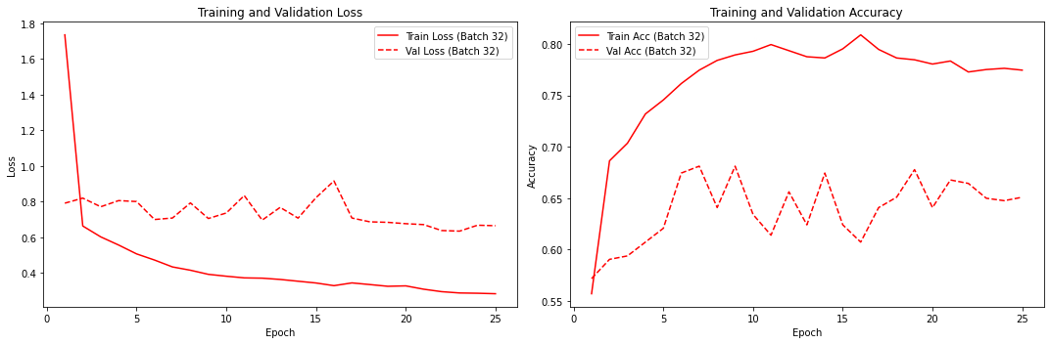
Add more layers
Per-class accuracies for batch size 32: [0.82142857 0.515625 0.5 ]
Batch Size: 32
Final Training Accuracy: 0.7745562195777893
Final Validation Accuracy: 0.6510066986083984
Final Test Accuracy: 0.675000011920929

Slide 11
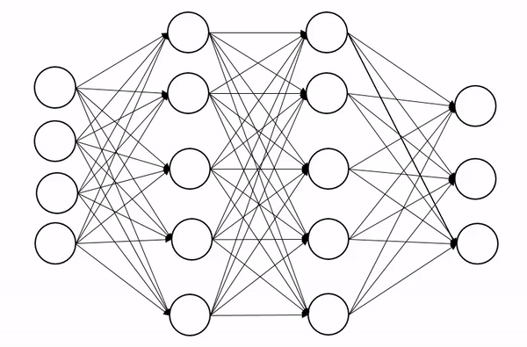



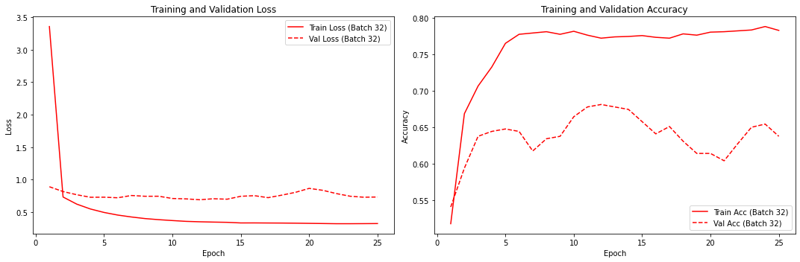
Dropout & Batch normalisation
Dropout on the second hidden layer of a neuron network
Batch Normalisation
Speed up training
67%
Handles internal covariant shift
Smoothen Loss Function
During training, some layer outputs are dropped at random. This makes the layer appear as having a different number of nodes and connectedness to the preceding layer
Batch normalization works by normalizing the output of a previous activation layer by subtracting the batch mean and dividing by the batch standard deviation.
Final Training Accuracy: 0.7828402519226074||Final Validation Accuracy: 0.6375839114189148||Final Test Accuracy: 0.66625
Exponential LR||Per-class accuracies : [0.66666667 0.703125 0.33333333]
Notes:
SIf your model is overfitting (training loss is much lower than validation loss), increase regularization. You can do this by increasing the dropout rate or adding L1 or L2 regularization to the dense layers.
A dropout network may take 2-3 times longer to train than a normal network. Finding a regularizer virtually comparable to a dropout layer is one method to reap the benefits of dropout without slowing down training.
Speed Up the Training
By Normalizing the hidden layer activation the Batch normalization speeds up the training process.
Handles internal covariate shift
It solves the problem of internal covariate shift. Through this, we ensure that the input for every layer is distributed around the same mean and standard deviation. If you are unaware of what is an internal covariate shift, look at the following example.
Internal covariate shift
Suppose we are training an image classification model, that classifies the images into Dog or Not Dog. Let’s say we have the images of white dogs only, these images will have certain distribution as well. Using these images model will update its parameters.

Slide 12
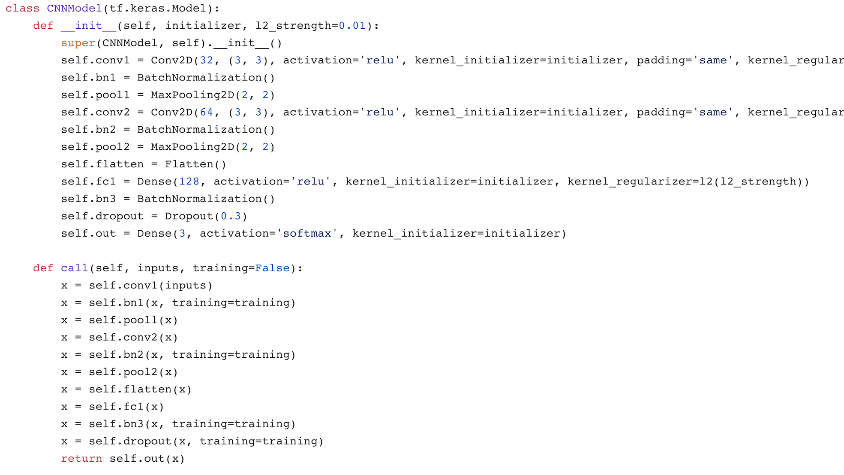

Slide 13
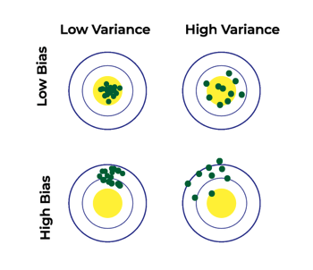
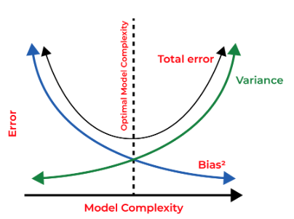
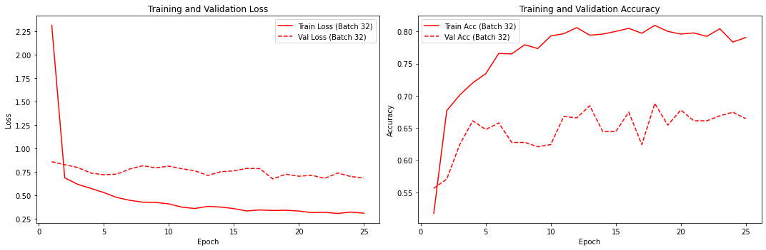
Weight decay -L2 Regularisation
An effective regularize will be the one that makes the best trade between bias and variance
High Bias, Low Variance
Underfitting
High Variance, Low Bias
Overfitting
High-Bias, High Variance
Sensitive to training data
Unreliable predictions
Low Bias, Low Variance
Perfect Scenario
(Not Feasible in reality)
68%
Training Accuracy: 0.7905325293540955||Validation Accuracy: 0.6644295454025269|| Test Accuracy: 0.6825000238418579
Per-class accuracies : [0.91666667 0.390625 0.33333333]
Notes:
Bias refers to the errors which occur when we try to fit a statistical model on real-world data which does not fit perfectly well on some mathematical model. If we use a way too simplistic a model to fit the data then we are more probably face the situation of High Bias which refers to the case when the model is unable to learn the patterns in the data at hand and hence performs poorly.
Variance implies the error value that occurs when we try to make predictions by using data that is not previously seen by the model. There is a situation known as high variance that occurs when the model learns noise that is present in the data.

Slide 14
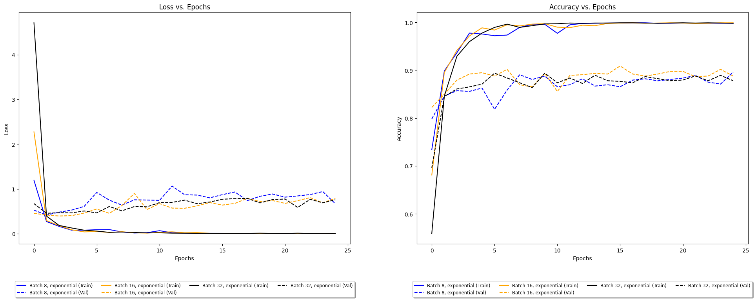
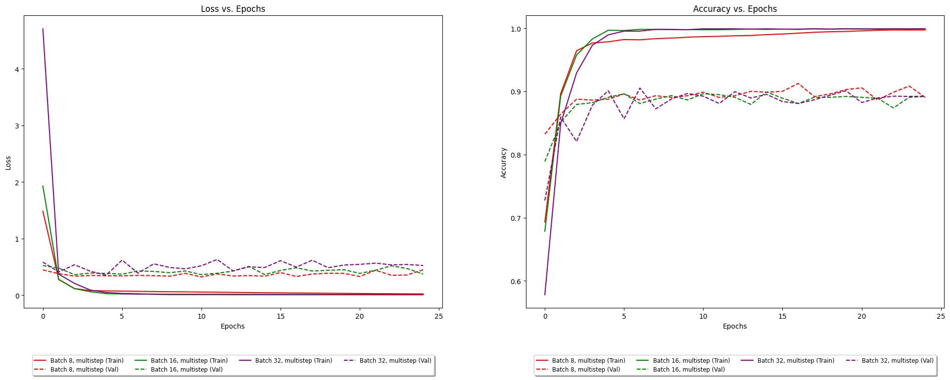
LR SCHEDULER
92%
Kaiming Uniform, Exponential LR
Kaiming Uniform, Multi-Step LR
Overall Test Accuracy: 0.9115811586380005
Accuracy for car: 0.9163292847503374
Accuracy for pedestrian: 0.9022108843537415
Accuracy for bike: 0.9193381592554292
Batch 8
Overall Test Accuracy: 0.9233703017234802 Accuracy for car: 0.9441489361702128
Accuracy for pedestrian: 0.8910472972972973
Accuracy for bike: 0.9472573839662447
Overall Test Accuracy: 0.9039528369903564
Accuracy for car: 0.9369127516778524
Accuracy for pedestrian: 0.8603491271820449
Accuracy for bike: 0.9337606837606838
Batch 16
Overall Test Accuracy: 0.9185159206390381 Accuracy for car: 0.9608636977058029
Accuracy for pedestrian: 0.882303132938188
Accuracy for bike: 0.9303534303534303
Overall Test Accuracy: 0.8907766938209534
Accuracy for car: 0.9041994750656168
Accuracy for pedestrian: 0.9164578111946533 Accuracy for bike: 0.8464864864864865
Batch 32
Overall Test Accuracy: 0.9088072180747986 Accuracy for car: 0.9310344827586207
Accuracy for pedestrian: 0.8736310025273799
Accuracy for bike: 0.9353128313891834

Slide 15
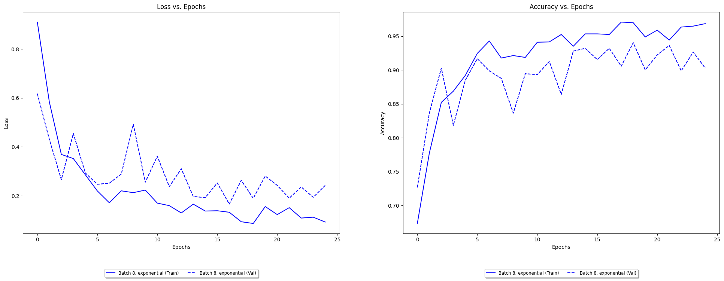
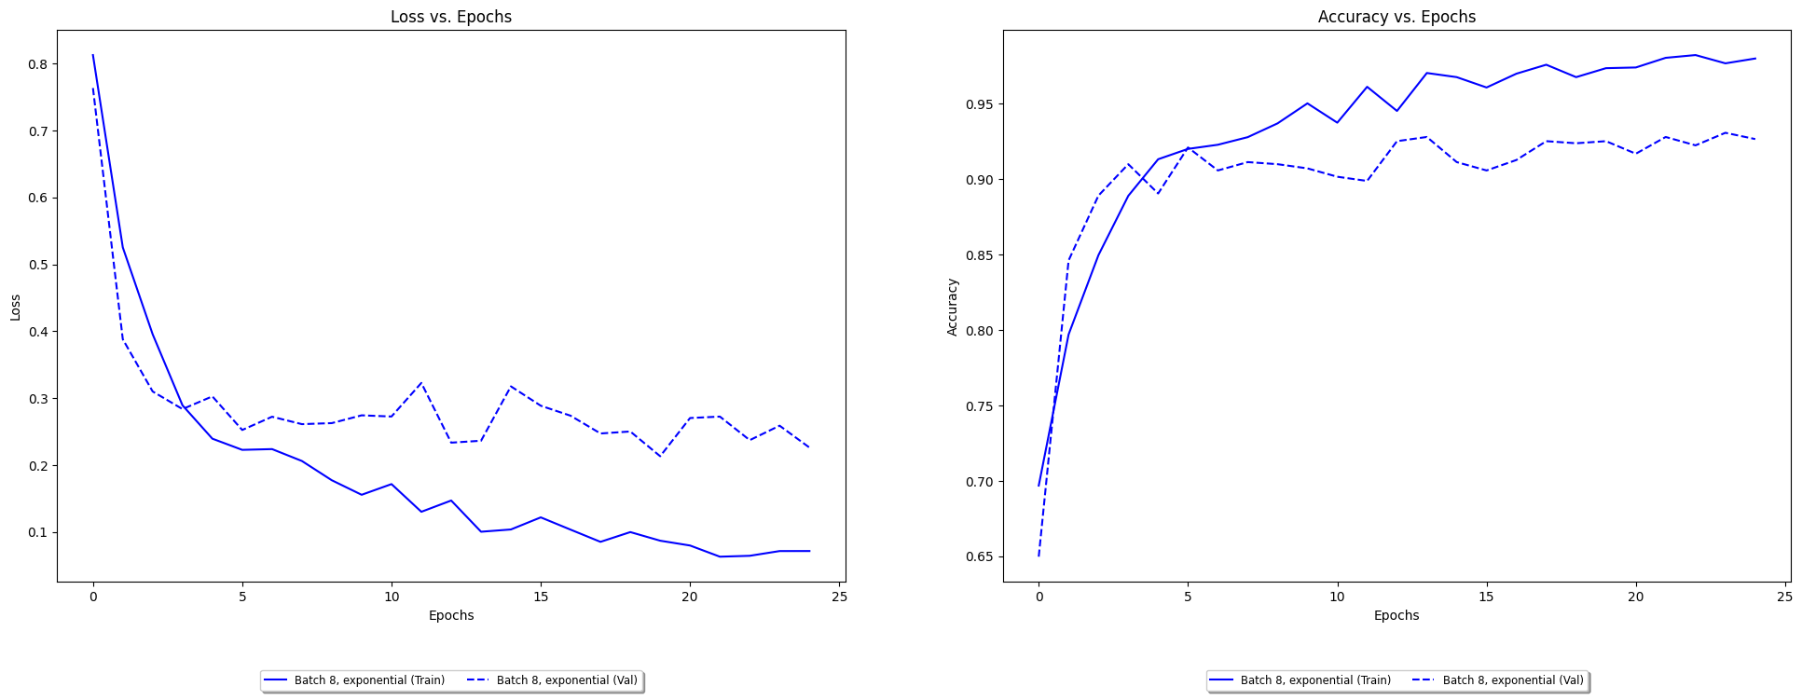
Hyper-Parameter tuning –Dropout(0.3), Batch Normalisation, L2 regulariser(0.01), EXP_LR, BATCH_SIZE = 8
93%
Convergence to Final Result
Lr_initial =0.001
Lr_initial =0.0001
Overall Test Accuracy: 0.9219833612442017 Accuracy for car: 0.9642857142857143
Accuracy for pedestrian: 0.8792517006802721 Accuracy for bike: 0.9411764705882353
Overall Test Accuracy: 0.9316921234130859 Accuracy for car: 0.9534246575342465
Accuracy for pedestrian: 0.9256474519632414 Accuracy for bike: 0.922675026123302

Slide 16
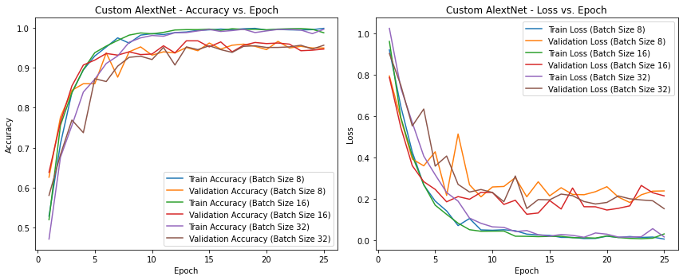
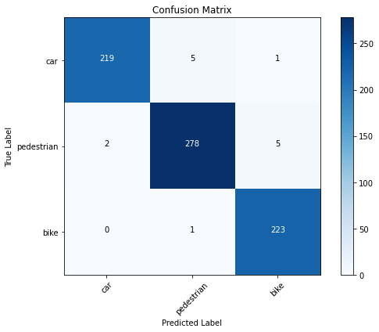
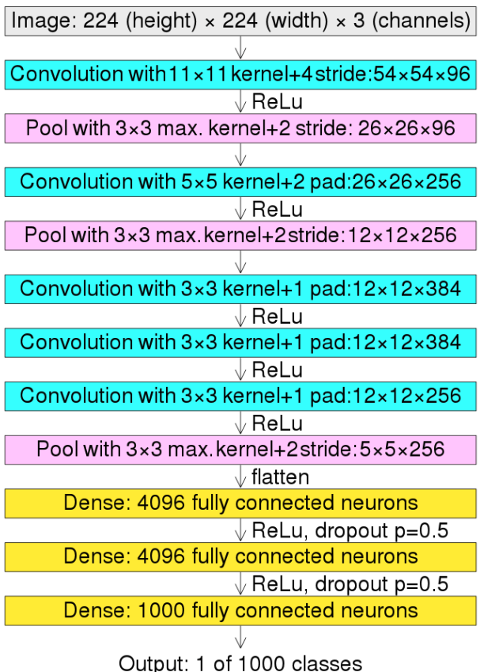
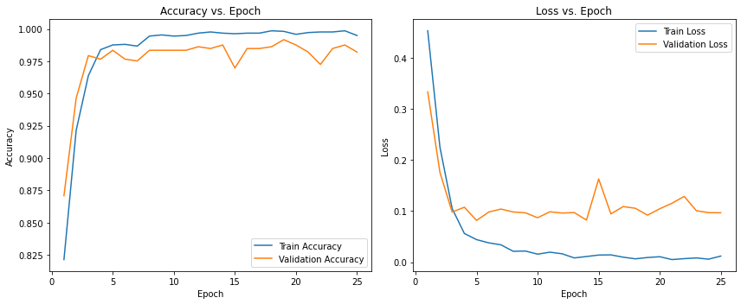
ALEXNET
Test Loss: 0.0535, Test Accuracy: 0.9809
Accuracy for class car: 0.9733
Accuracy for class pedestrian: 0.9754
Accuracy for class bike: 0.9955
98%
8 layers with learnable parameters
Architecture: 5 Conv Layers with MaxPooling
3 FC layers
Activation Function: ReLU
Dropout rate 0.5
Softmax Classifier

Slide 17
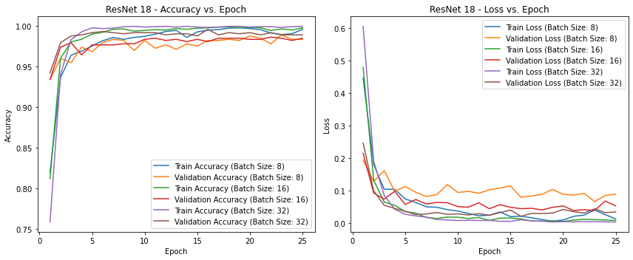
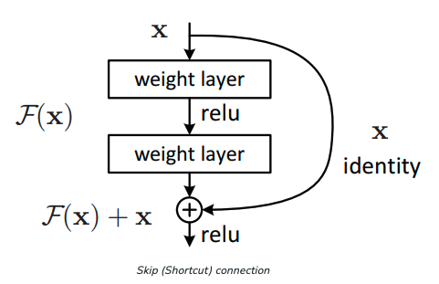
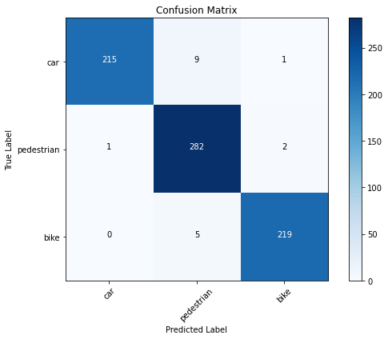
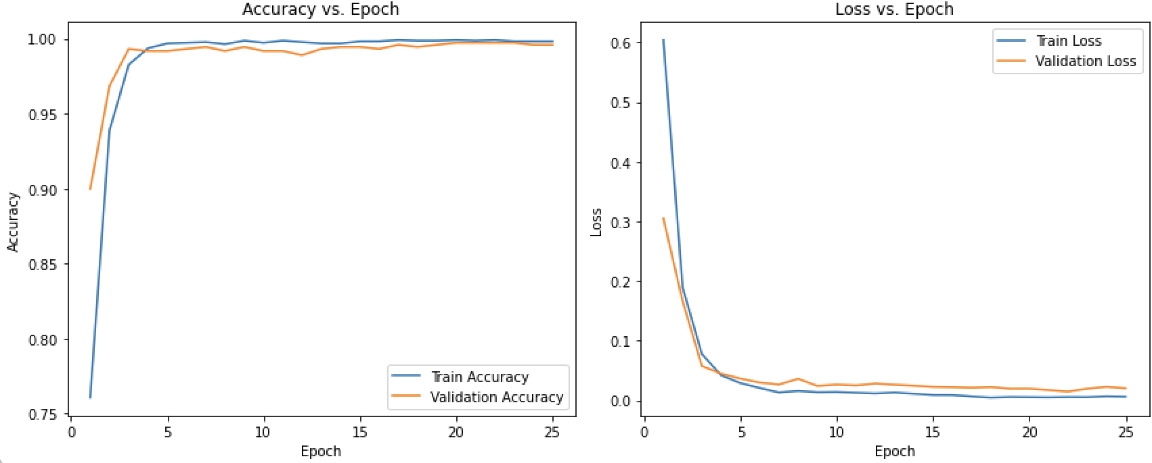
REsnet18-Deep Residual learning
Performs well at Batch Size 32
Test Loss: 0.0585, Test Accuracy: 0.9781
Accuracy for class car: 0.9633
Accuracy for class pedestrian: 0.9755
Accuracy for class bike: 0.9954
98%
Solve Vanishing Gradient problem
Deep network causes gradients to shrink to zero, causing weights to never update and therefore no learning occurs
Technique- ‘Skip Connections’

Slide 18
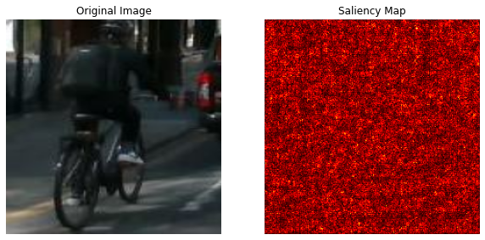
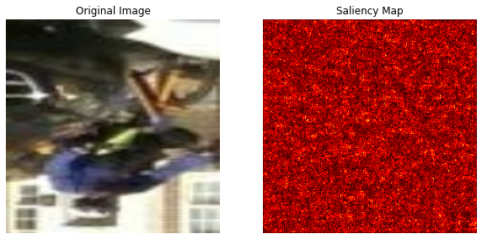
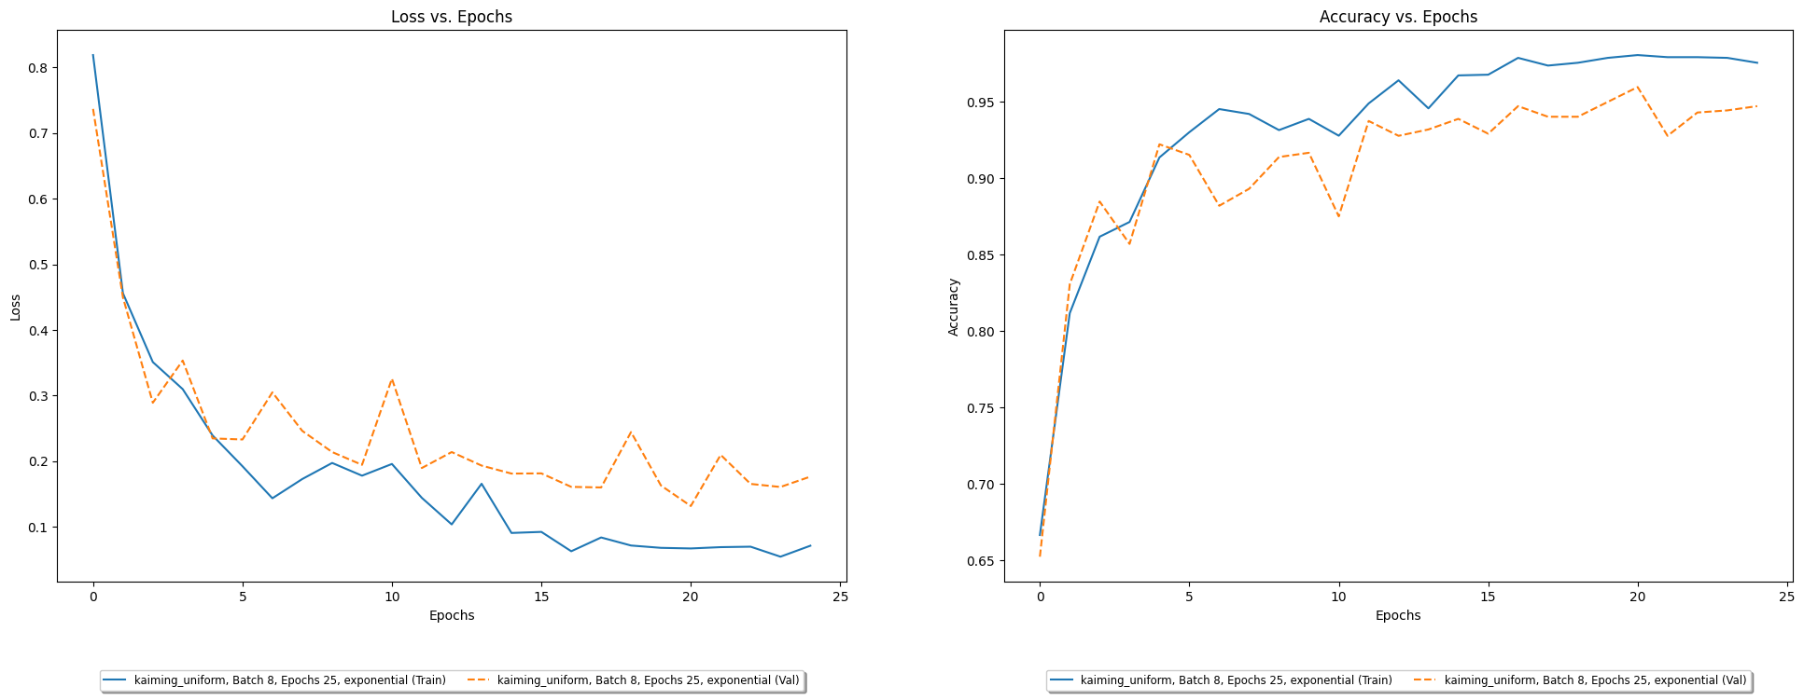
Custom cnn model with gradcam Based Saliency map
Saliency maps are heatmap that highlight the pixels of the input image that caused the output classification
Pixels correspond to object location in image.
Training complete with kaiming_uniform initializer, batch size 8, 25 epochs, and exponential learning rate schedule.
Overall Test Accuracy: 0.9409340620040894
Accuracy for car: 0.9502262443438914
Accuracy for pedestrian: 0.8921933085501859
Accuracy for bike: 0.9873949579831933

Slide 19
THANK YOU

